Slide 1
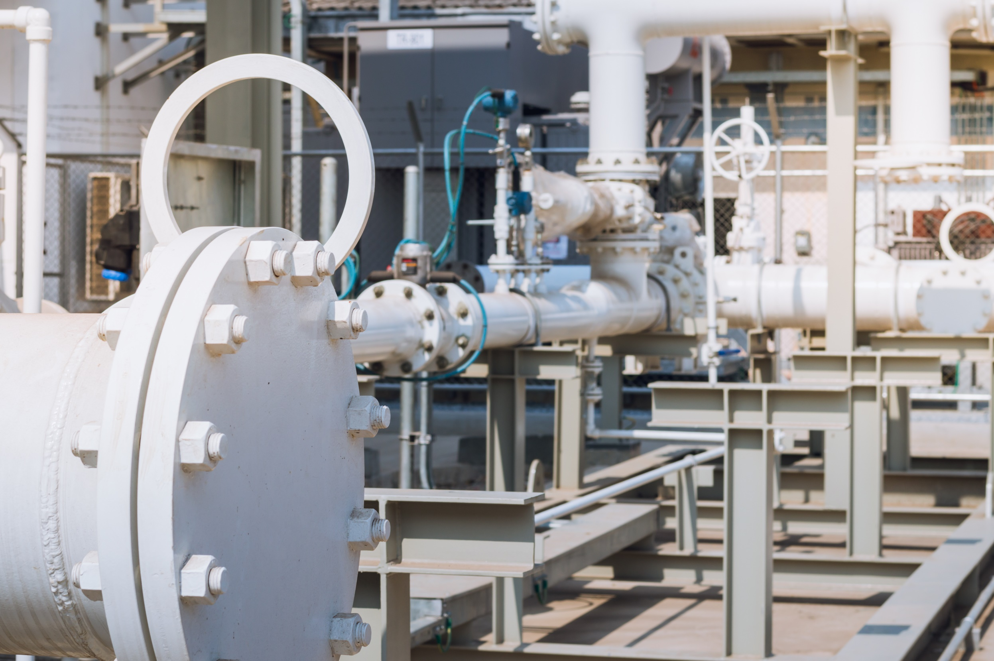


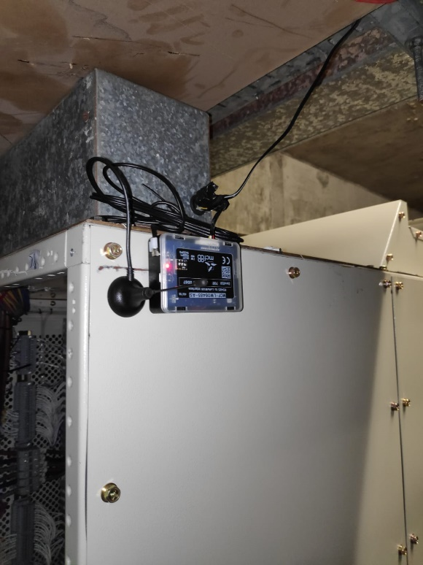
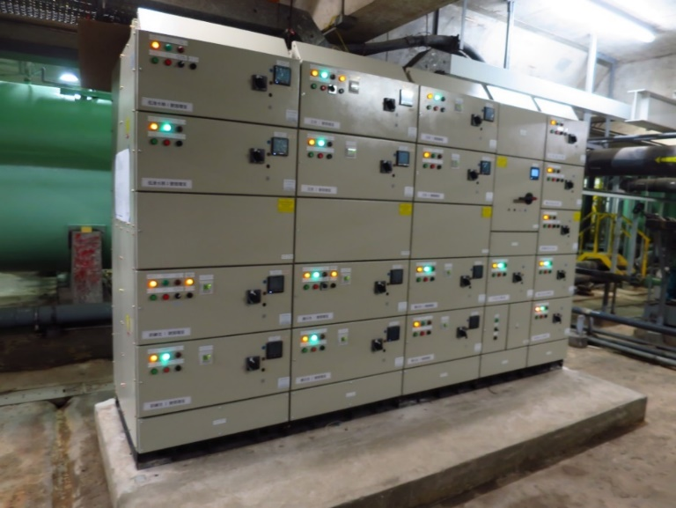
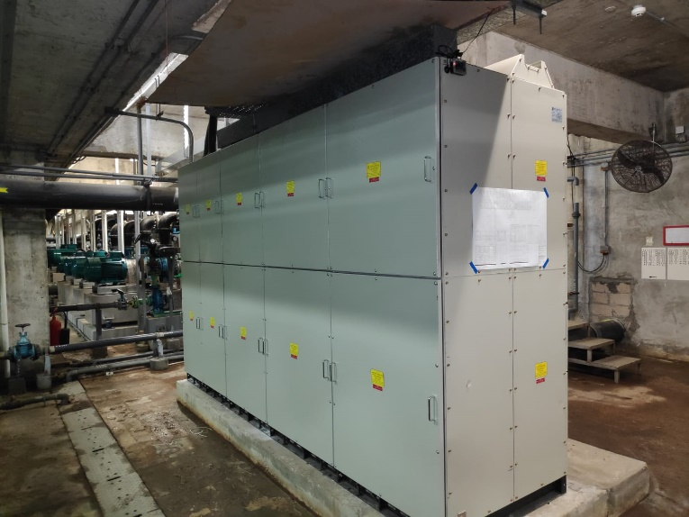
1
ALARM SYSTEM
  Remote monitoring of filtration plant pump status
Filtration Pump Panel
LoRA RS485 Device

Slide 2
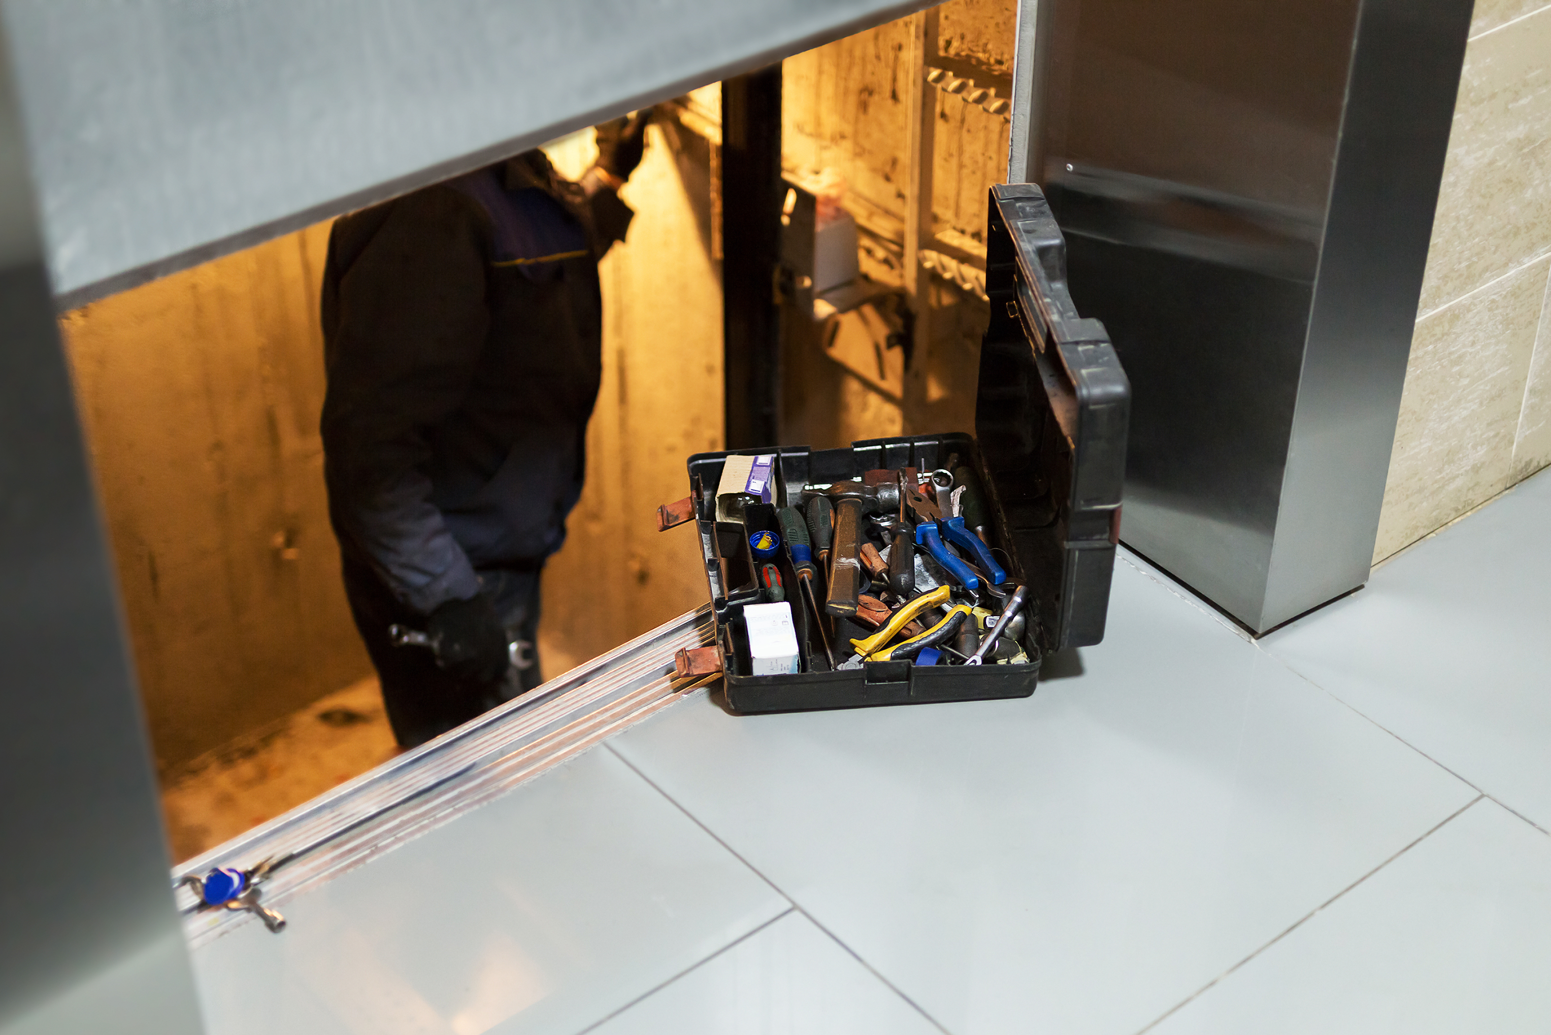
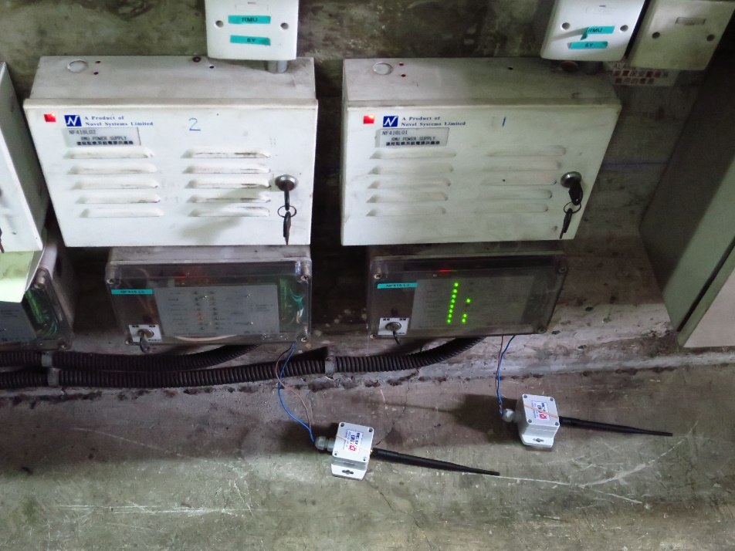
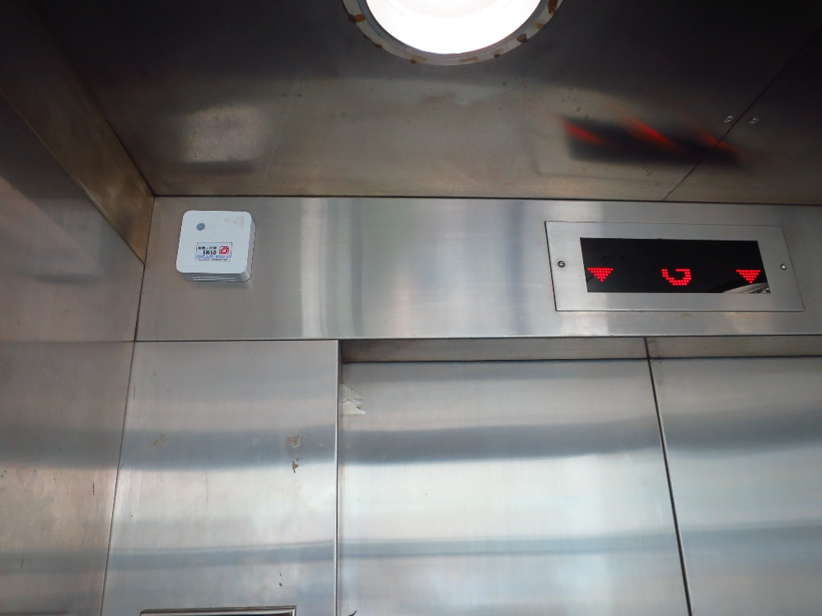
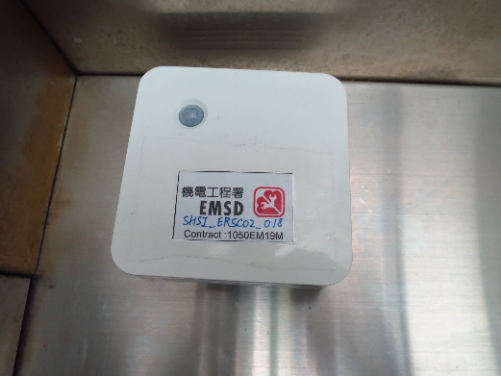
1
ALARM SYSTEM
  Escalator fault alarm, lift car temp &
  humidity remote monitoring via LoRA
Dry Contact Device
Temp & Humidity Sensor

Slide 3

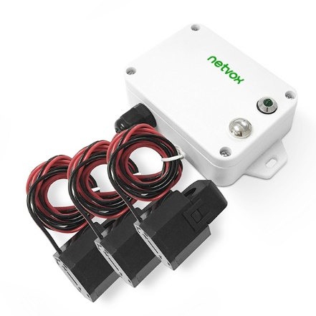

2
REMOTE MONITORING SYSTEM
  Measurement current of power supply to chiller
  Current & T&H sensors
  Heat pump operation status monitoring

Slide 4

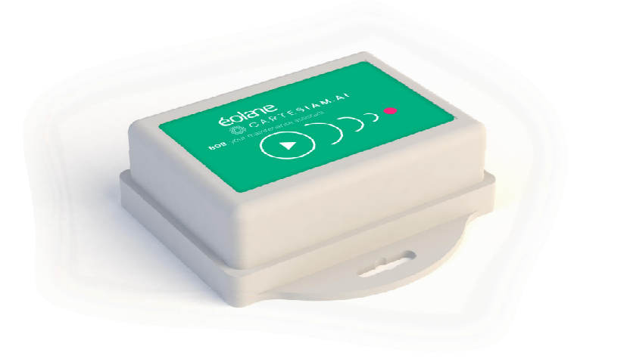

3
Vibration Sensor
Air Compressor, Engine, Cold Group Air Conditioner,
Transformer, Power Generator, Pump, etc.
Power Supply, Rotating Machines
Vibration Pattern Detection

Slide 5
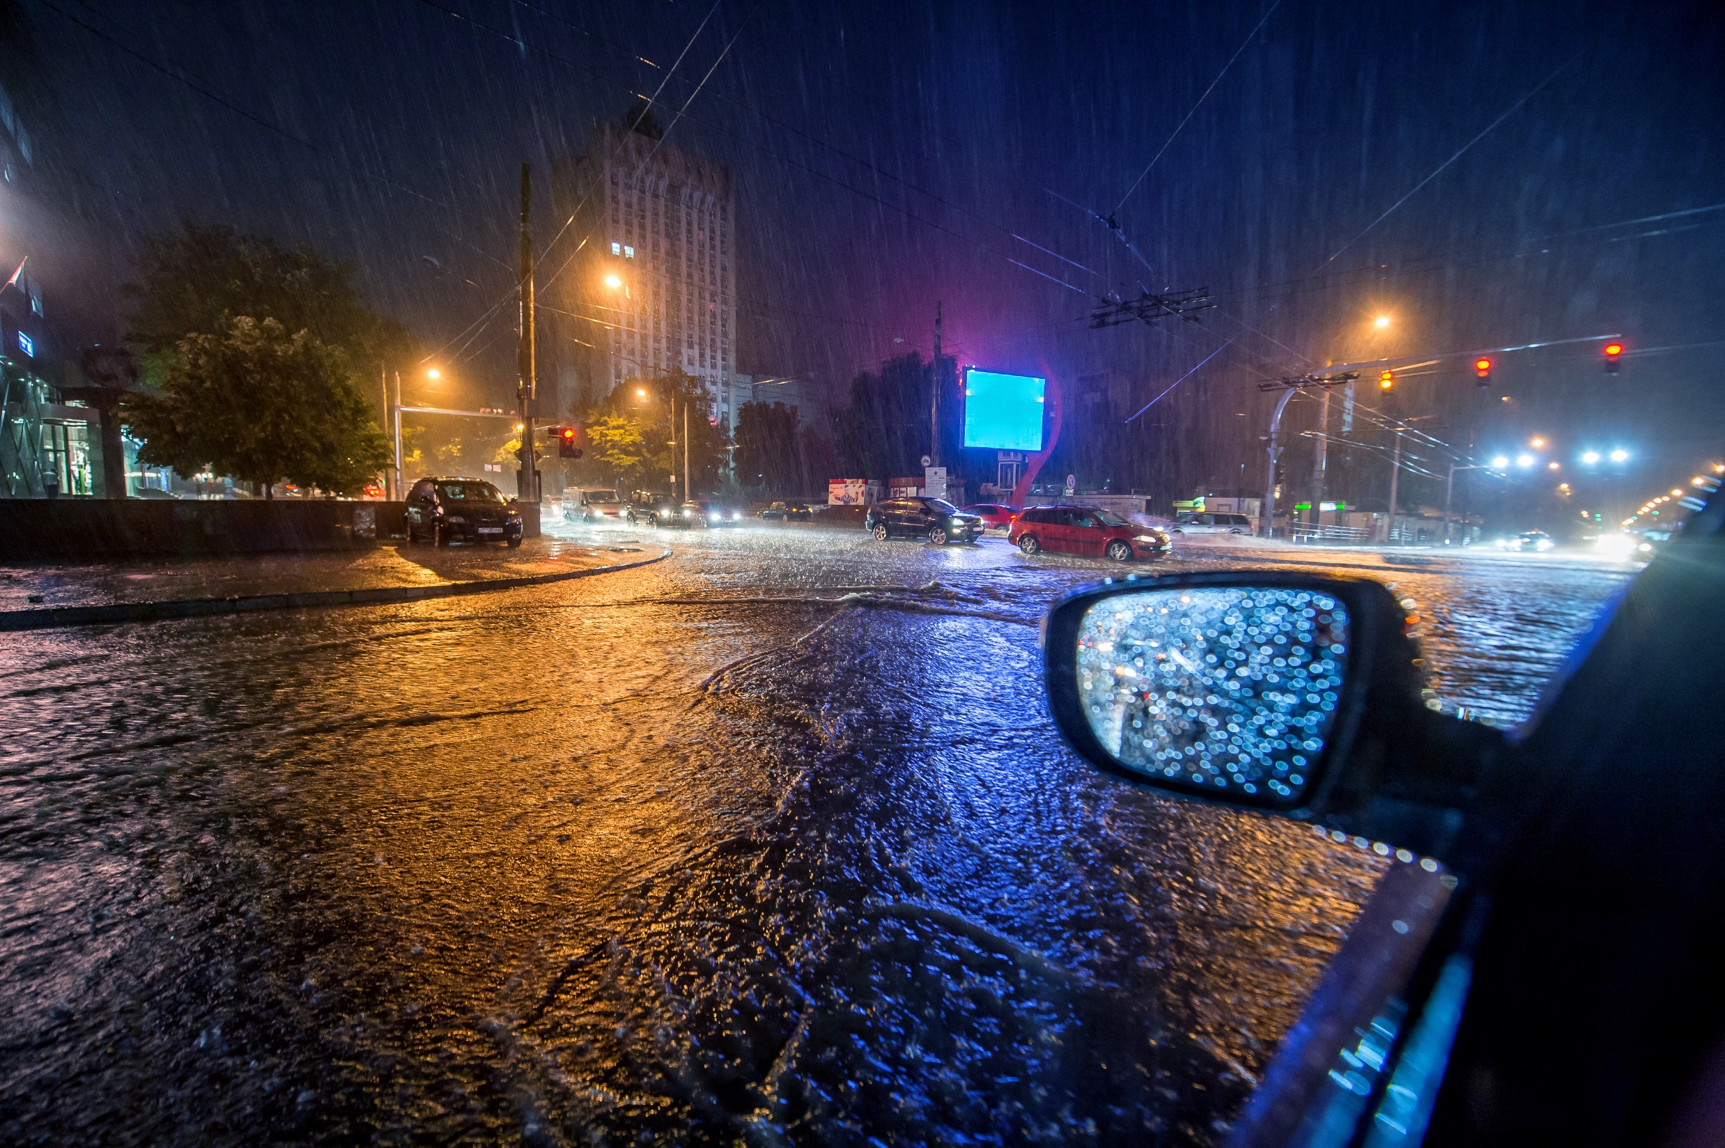

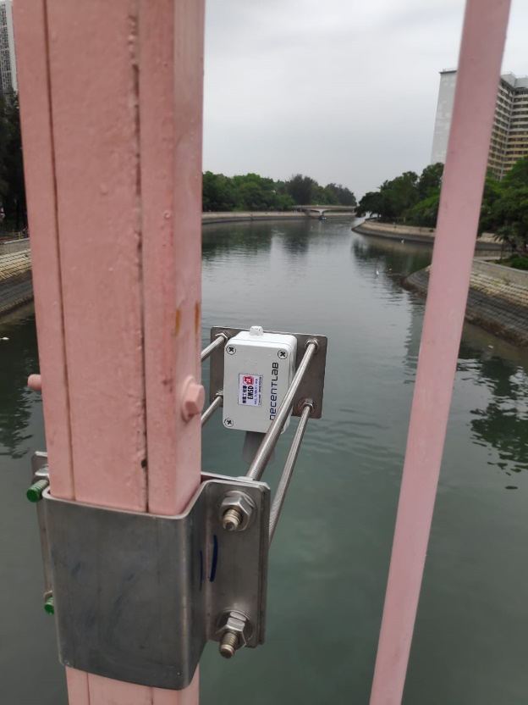
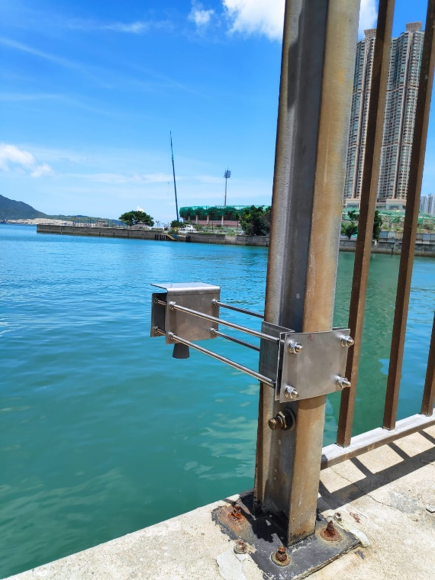
4
WATER LEVEL SENSING
Water Level Monitoring
Fast deployment of water level sensor for flood monitoring

Slide 6
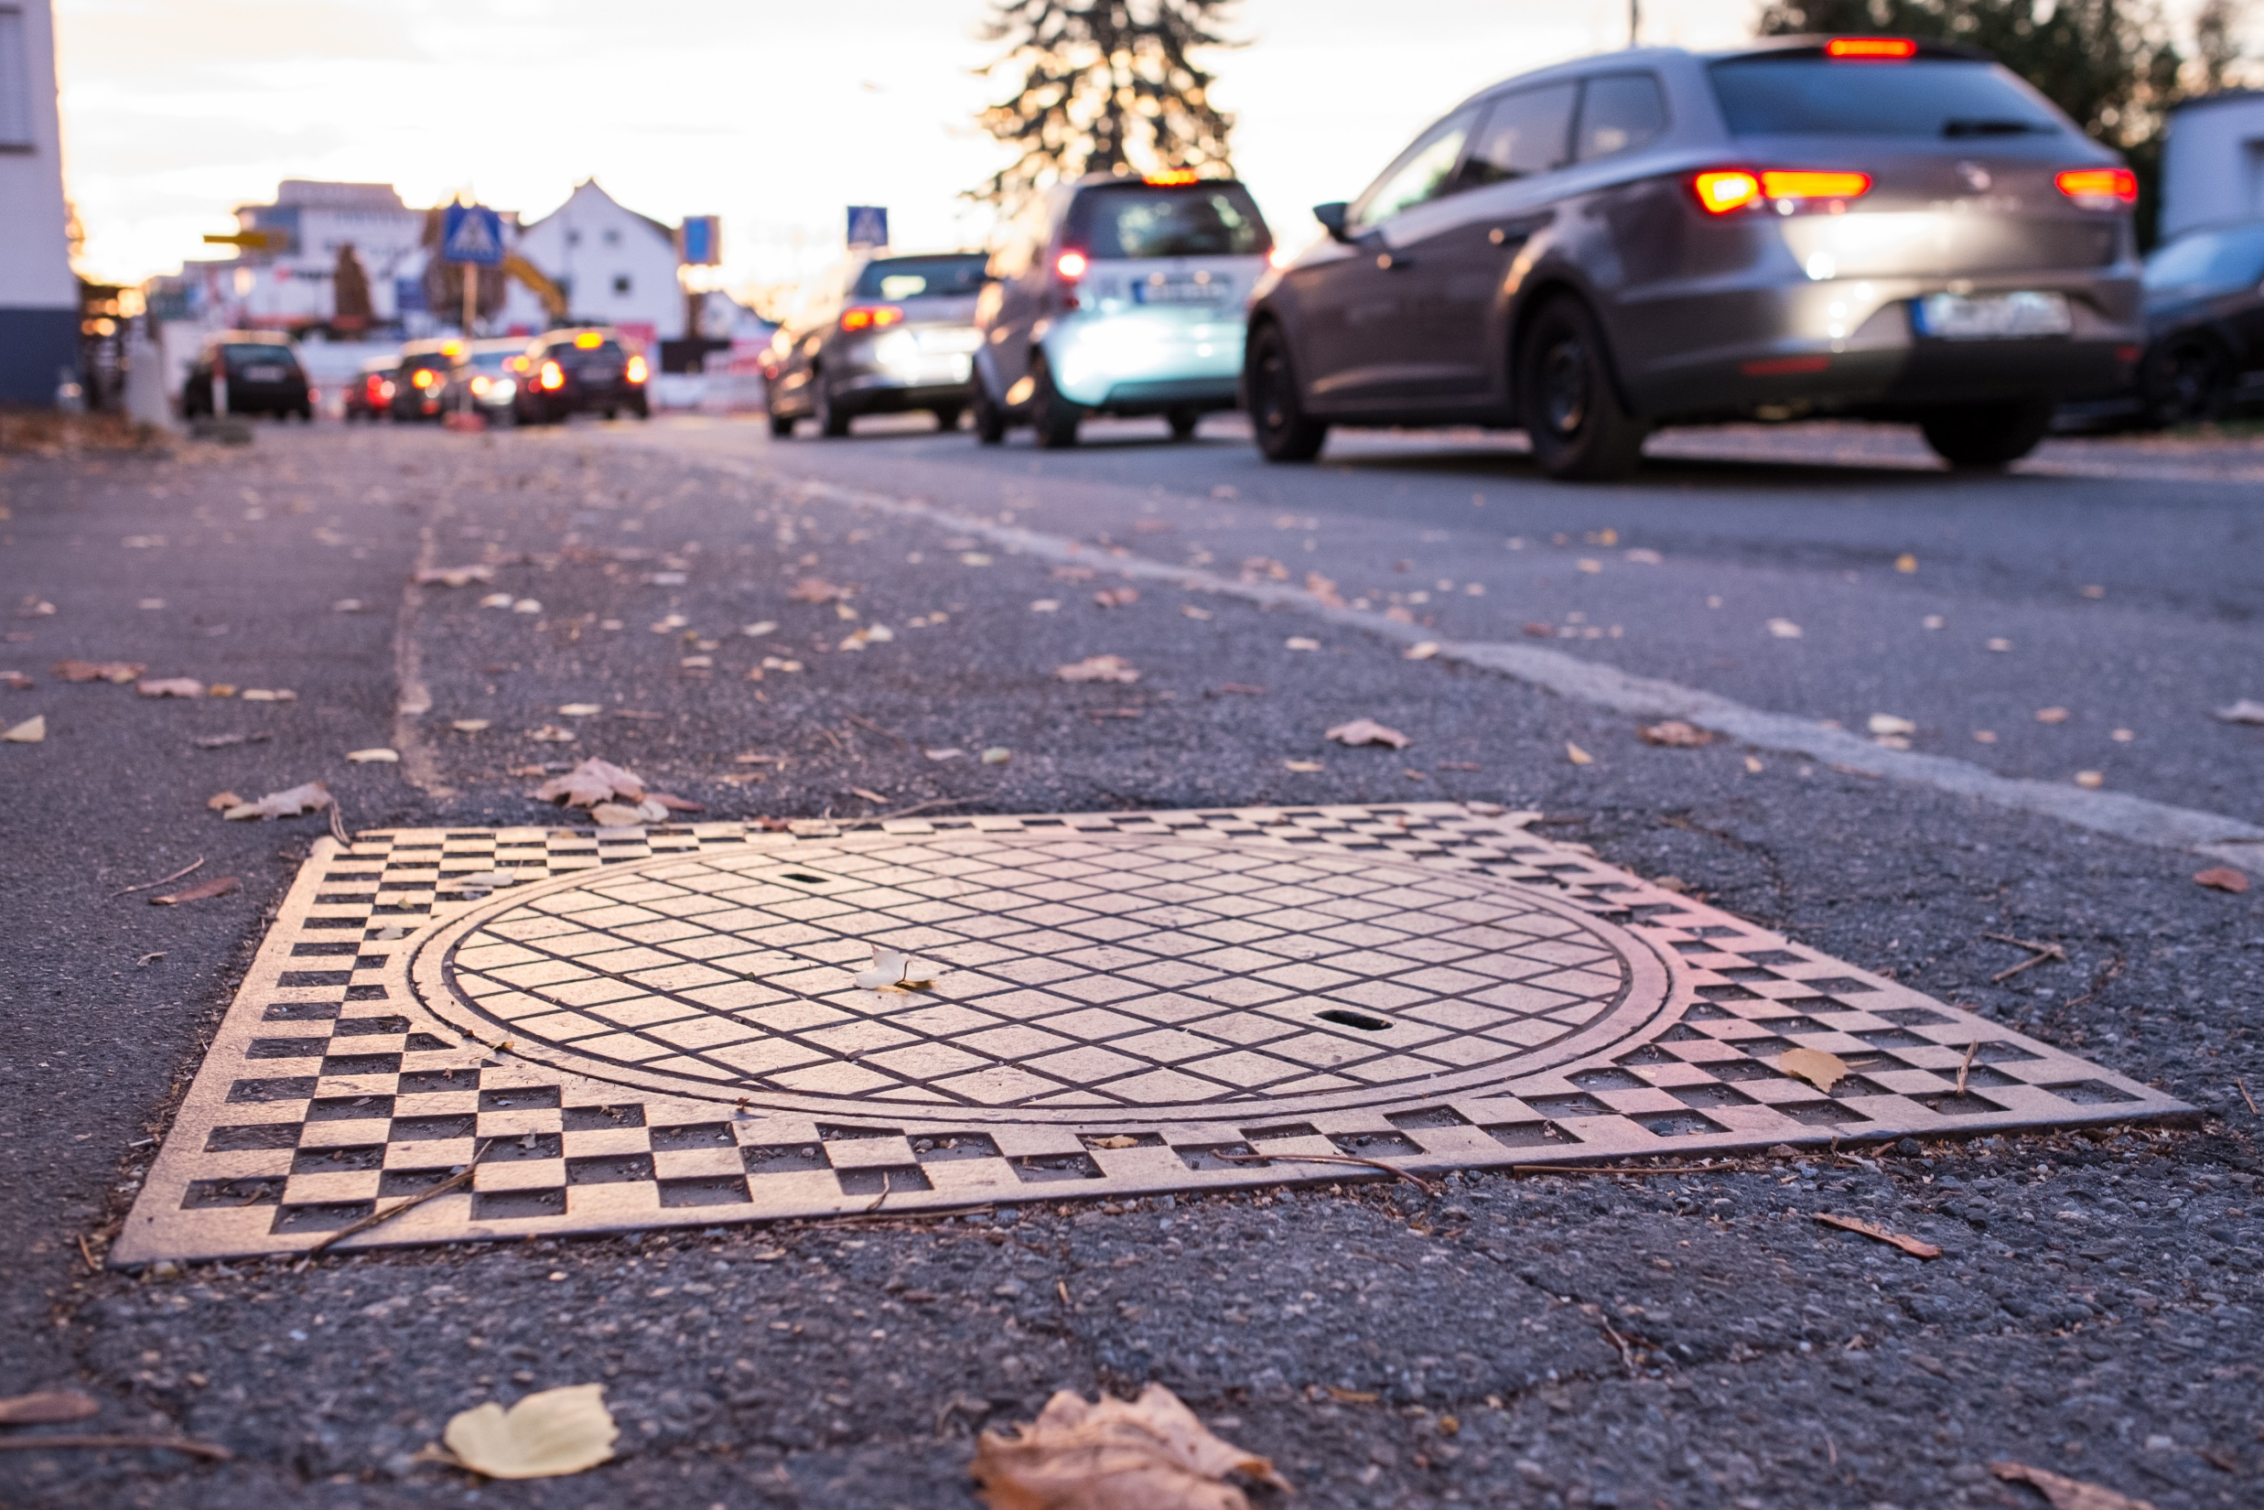

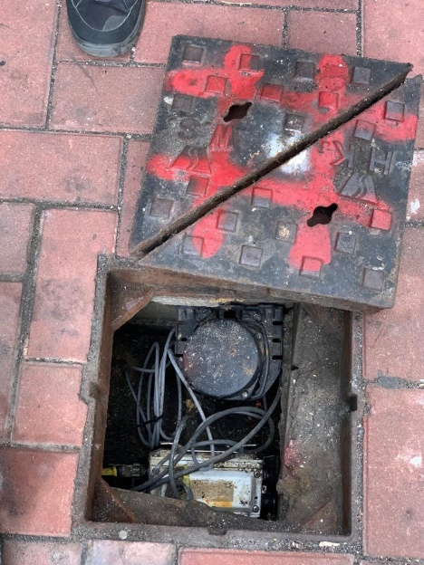
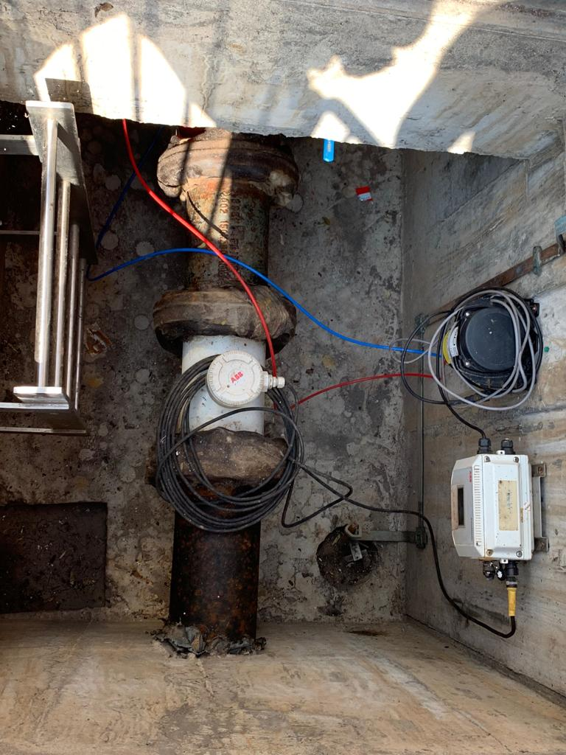
5
DRAINAGE SYSTEM
  Retrofitting existing flow meter and data logger with
  LoRa Module
  Collecting water flow data for multiple junctions point
  water leakage detection

